Slide 1

CIA Triad Case Study
28811 – Anuj Sen

Slide 2
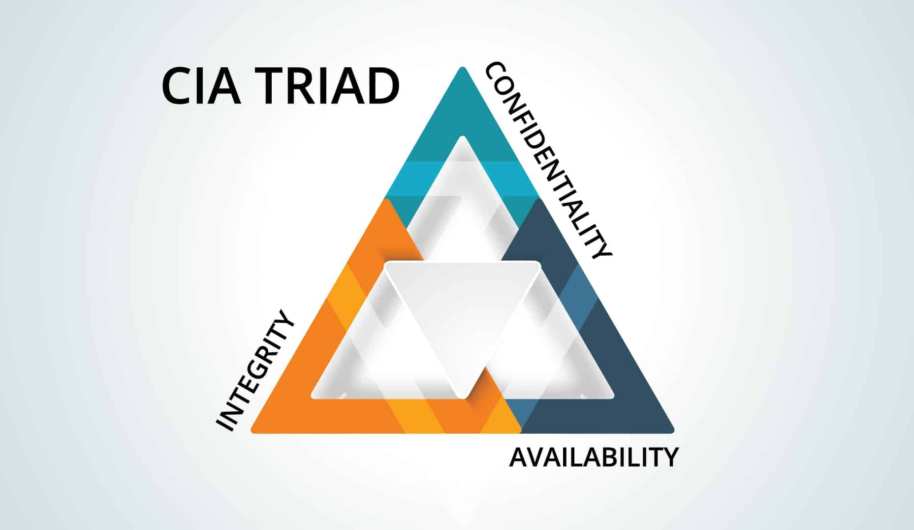
-

Slide 3

Confidentiality
Confidentiality refers to protecting information from unauthorized access.
Data confidentiality simply means keeping sensitive or personal information private, ensuring that only authorized individuals can access it. It's about protecting data from unauthorized disclosure or access.
Ex-HTTPS,Whatsapp

Slide 4

Integrity
Integrity means data are trustworthy, complete, and have not been accidentally altered or modified by an unauthorized user.
Data integrity ensures data is accurate, complete, and consistent throughout its lifecycle. It's about making sure data is reliable, preventing loss, or unauthorized changes. This means the data Encrypted like SHA-256,SSL Certificates.

Slide 5

Availability
Availability means data are accessible when you need them.
Data availability means having access to the data when and how you need it. It ensures that data is readily accessible for analysis, decision-making, and other purposes.
Ex- AWS stores 2 backups at 2 different Data Centre

